Slide 1
Major League Baseball Team Performance Analysis
By K + 1
Zachary De Den, Mehedi Toufiqe, Isaac Clark
STAT 4355

Slide 2
Data Set Information
The data set, Lahman Baseball Database, was created by and is updated yearly by Sean Lahman.
The database contains all recorded Major League Baseball statistics from 1871 to current day.
For the purpose of this project, we are constricting our analysis to the ‘modern’ era of baseball (years 1970 to 2019).
Years 1972, 1981, and 1994 were not included because the regular season was affected by player strikes.
Response Variable: Winning Percentage
Predictor Variables: Batting Average, Extra Base-hits per Game, Strikeouts per Game, Walks per Game, Hits Allowed per Game, Strikeouts Allowed per Game, Walks Allowed per Game, Earned Run Average
These predictors were chosen after careful thought to avoid extreme multicollinearity, as most baseball statistics are computed using the same discrete information.
Our analysis goal is to determine the characteristics that affects a team’s winning percentage for all years from 1970 to 2019, while also looking at each decade individually.

Slide 3
Predictor and Response Variable Description
Predictors:
Batting Average: H/AB
Extra Base-hits per Game: (X2B + X3B + HR)/G
Strikeouts per Game: SO/G
Walks per Game: BB/G
Hits Allowed per Game: HA/G
Strikeouts Allowed per Game: SOA/G
Walks Allowed per Game: BBA/G
Earned Run Average: (ER/IPouts)*9
Response:
Winning Percentage: W/G
H = Hits
AB = At Bats
G = Games
X2B = Doubles
X3B = Triples
HR = Home Runs
SO = Strikeouts
BB = Walks
SOA = Strikeouts Allowed
BBA = Walks Allowed
ER = Earned Runs
IPouts = Innings Pitched

Slide 4
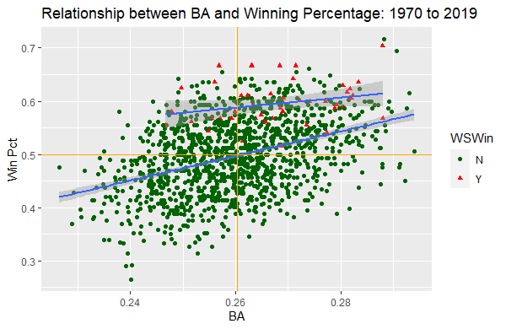
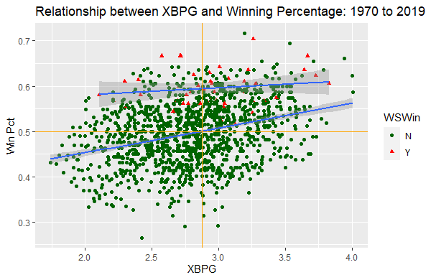
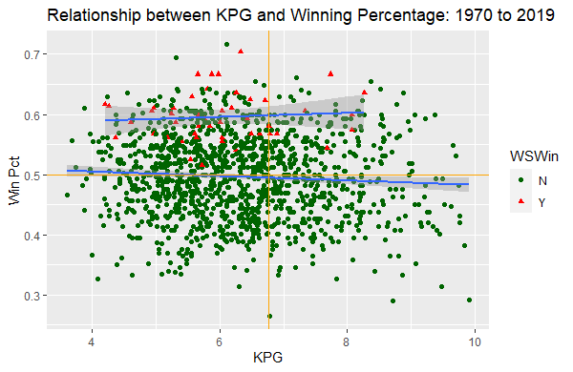
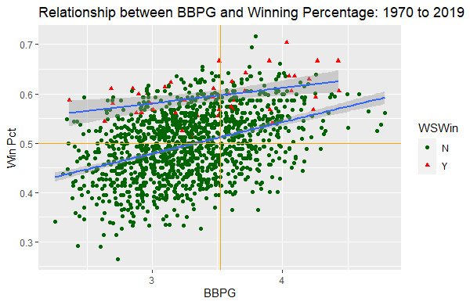
Notes:
We can see from these first four graphs, teams that won the World Series skewed towards a higher batting average and lower strikeouts per game, and are distributed approximately even on the extra base-hits per game and walks per game.

Slide 5
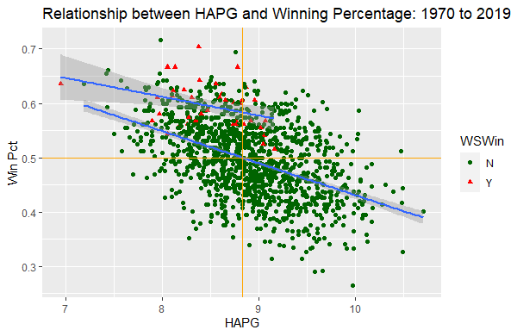
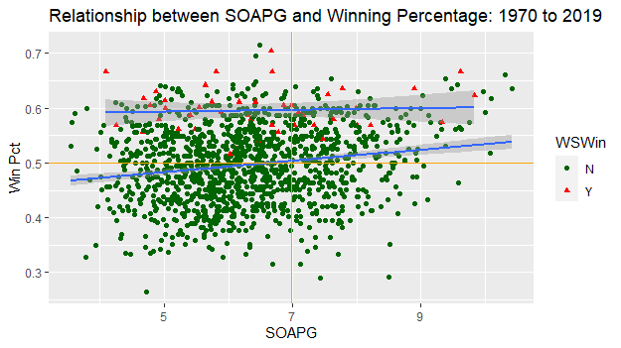
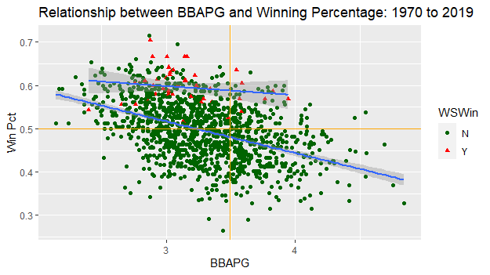
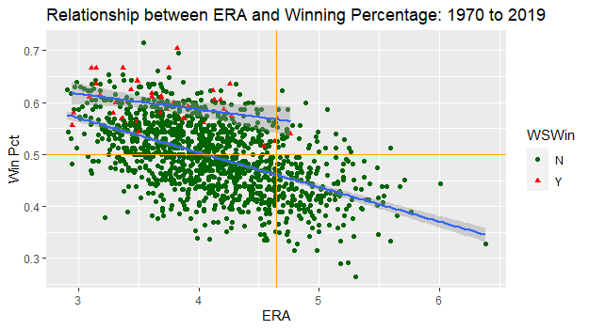
Notes:
Here again, we can see that teams that won the World Series skewed towards a lower hits allowed per game, walks allowed per game, and earned run average, while strikeouts allowed per game is remarkably constant.

Slide 6
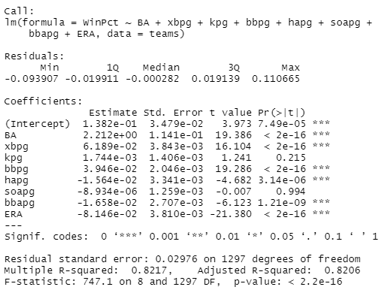
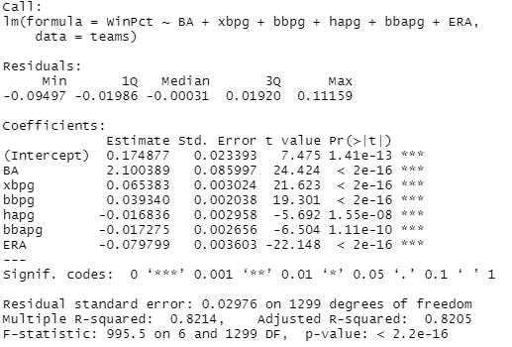
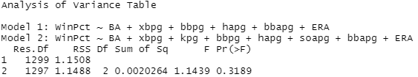
Analysis for years 1970 to 2019
Regression summary for full model fit yielded a p-value > 0.05 for kpg and soapg, thus they were removed.
The reduced model resulted:
WinPct = 2.100389(BA) + 0.065383(xbpg) + 0.039340(bbpg) – 0.016836(hapg) – 0.017275(bbapg) – 0.079799(ERA)
New model passes ANOVA check
VIFs all less than 10

Slide 7
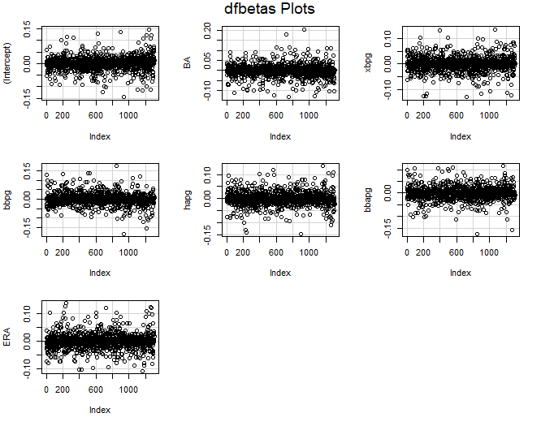
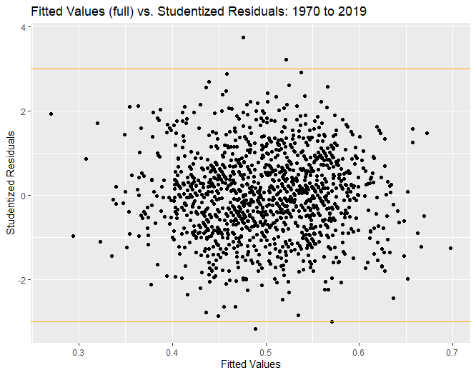
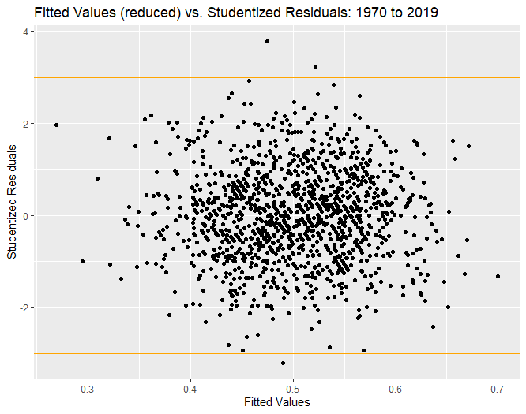
Analysis for years 1970 to 2019
No other transformation on data is necessary, as residuals are randomly distributed between -3 and 3 in a horizontal band
Three possible outliers noticed.

Slide 8
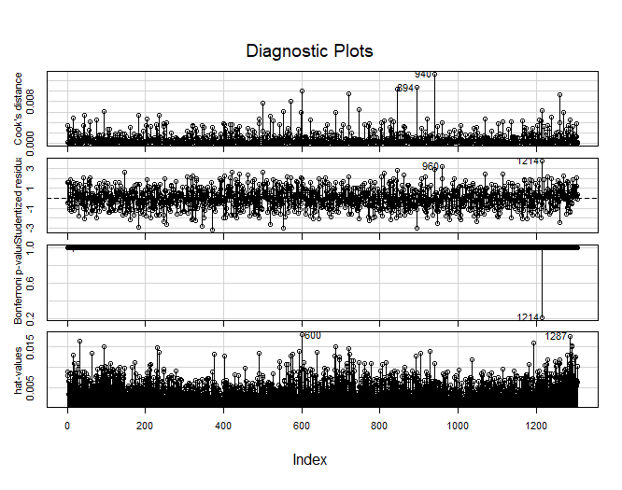
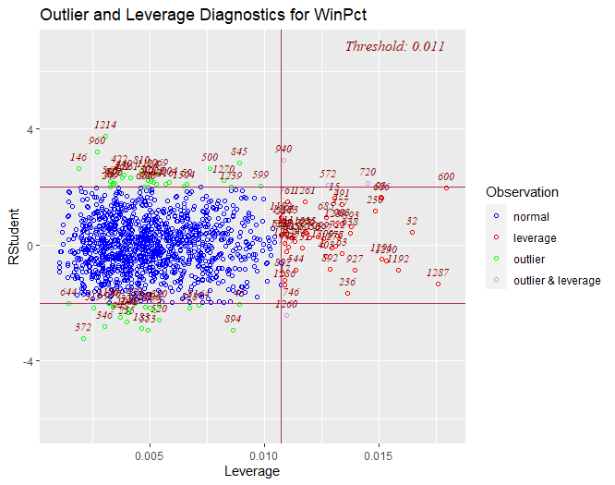
Analysis for years 1970 to 2019
Possible outliers at point 372 (the 1986 Pittsburgh Pirates), point 960 (the 2008 Los Angeles Angels), and point 1214 (the 2016 Texas Rangers).
Outlier teams that possibly over-performed (‘08 LAA, ‘16 TEX) made the playoffs in their respective years but did not win the World Series.
Further analysis of outliers and high leverage points can be conducted on why these teams either significantly over- or under-performed.

Slide 9
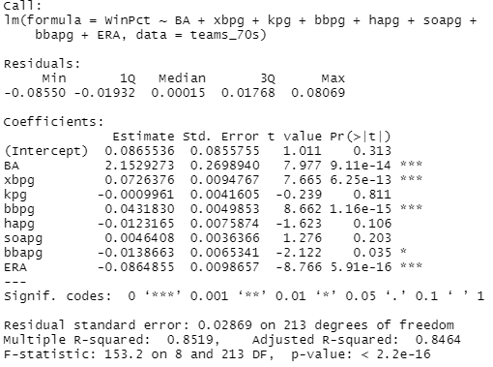
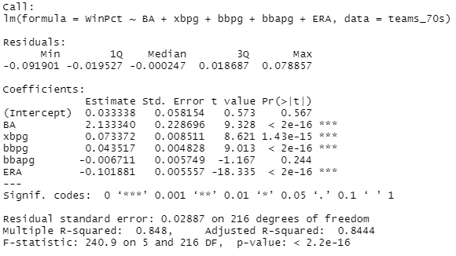
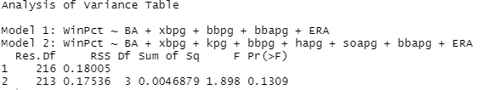
Analysis for years 1970 to 1979
Regression summary for full model fit yielded a p-value > 0.05 for kpg, hapg, soapg, thus they were removed.
The reduced model resulted:
WinPct = 2.133340(BA) + 0.073372(xbpg) + 0.043517(bbpg) – 0.006711(bbapg) – 0.101881(ERA)
New model passes ANOVA check
VIFs all less than 10

Slide 10
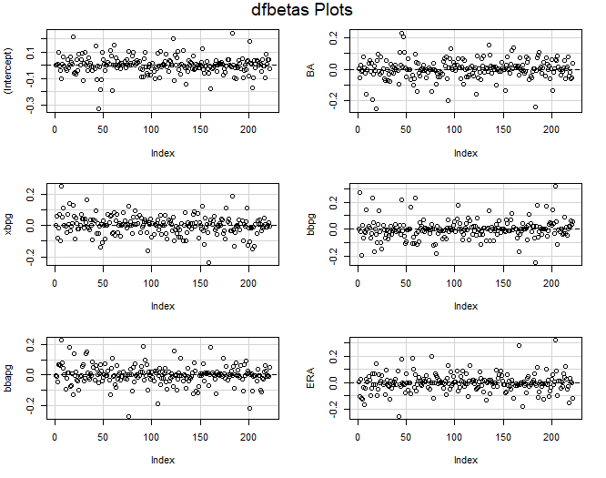
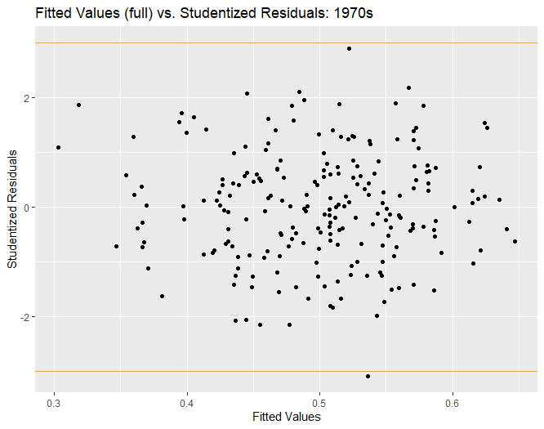
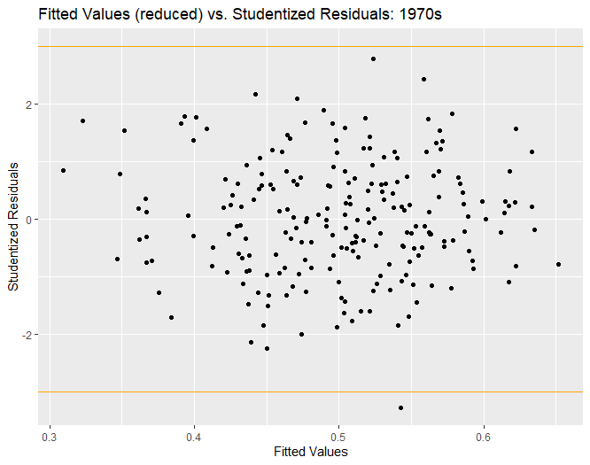
Analysis for years 1970 to 1979
No other transformation on data is necessary, as residuals are randomly distributed between -3 and 3 in a horizontal band
One possible outlier noticed.

Slide 11
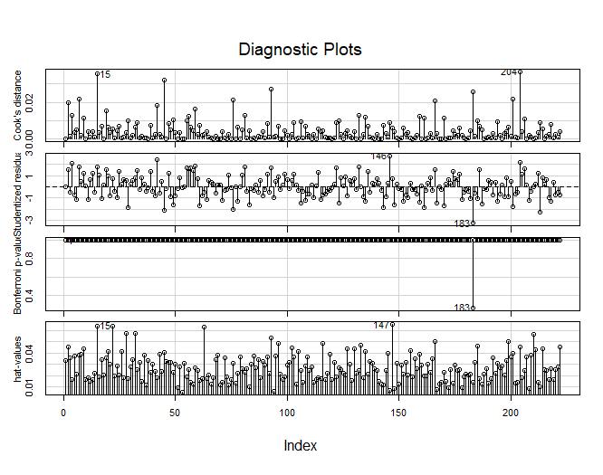
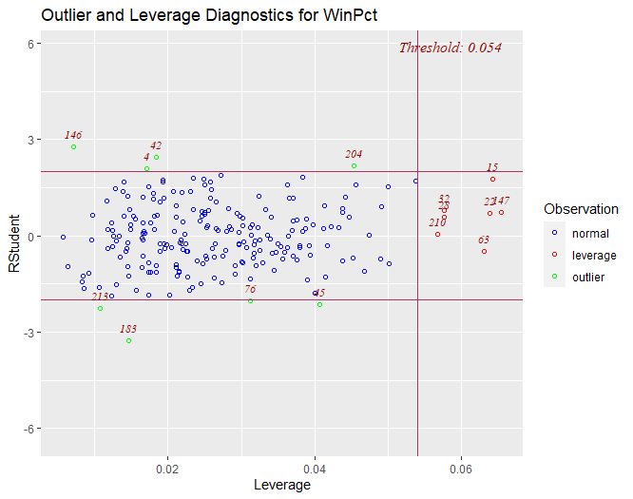
Analysis for years 1970 to 1979
Possible outlier at point 183 (the 1978 Minnesota Twins).
Outlier team did not win the World Series that year (did not even make the playoffs).
Further analysis of outlier and high leverage points can be conducted on why these teams either significantly over- or under-performed, respective to the decade they played.

Slide 12
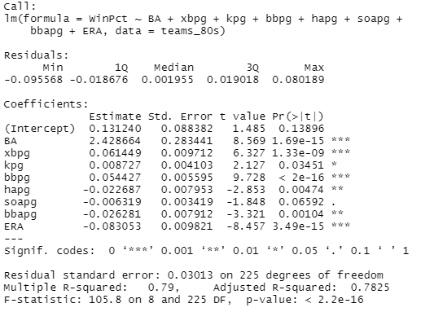
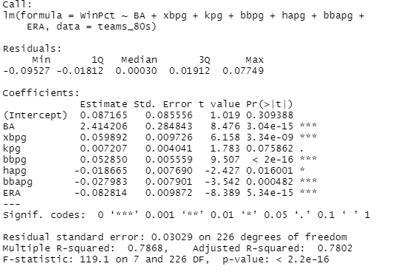
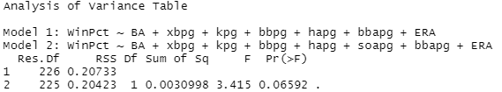
Analysis for years 1980 to 1989
Regression summary for full model fit yielded a p-value > 0.05 for soapg, thus it was removed.
The reduced model resulted:
WinPct = 2.414206(BA) + 0.059892(xbpg) + 0.007207(kpg) + 0.052850(bbpg) – 0.018665(hapg) – 0.027983(bbapg) – 0.082814(ERA)
New model passes ANOVA check
VIFs all less than 10

Slide 13
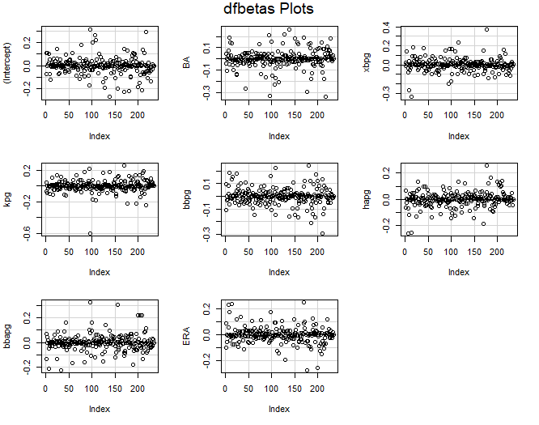
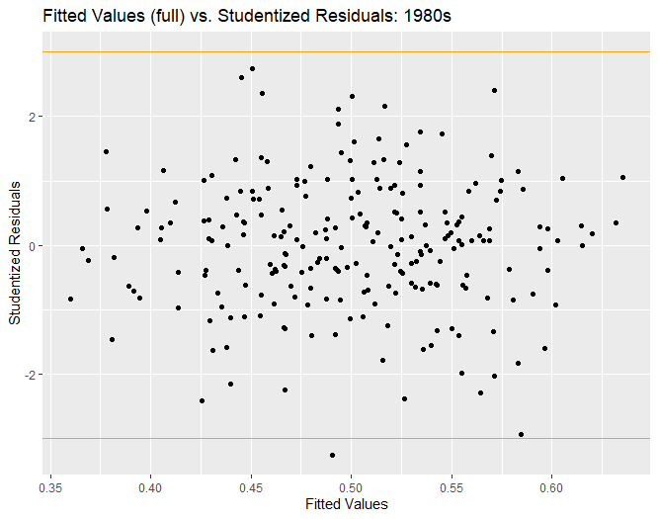
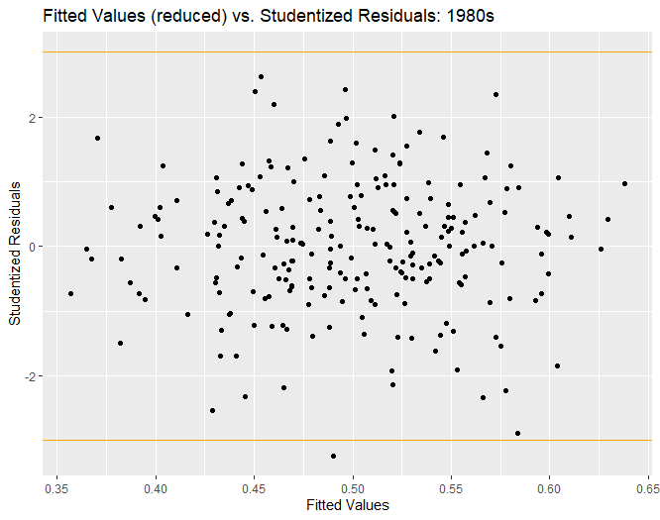
Analysis for years 1980 to 1989
No other transformation on data is necessary, as residuals are randomly distributed between -3 and 3 in a horizontal band
One possible outlier noticed.

Slide 14
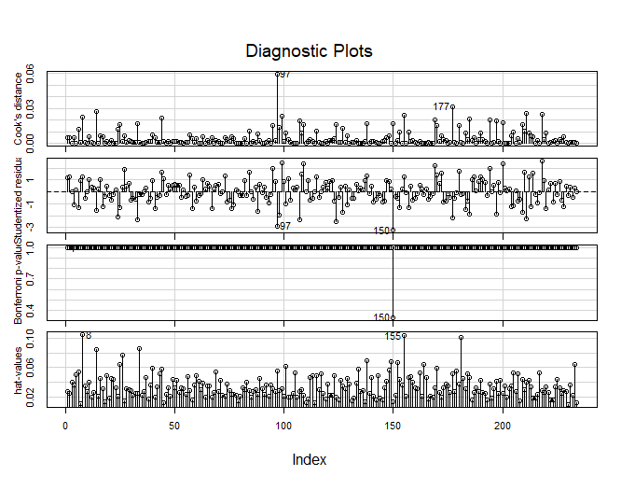
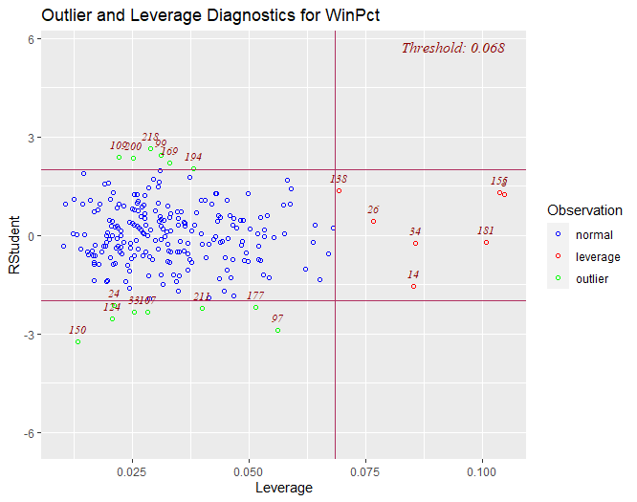
Analysis for years 1980 to 1989
Possible outlier at point 150 (the 1986 Pittsburgh Pirates).
Outlier in this decade is an overall outlier for all years from 1970 to 2019.
Further analysis of outlier and high leverage points can be conducted on why these teams either significantly over- or under-performed, respective to the decade they played.

Slide 15
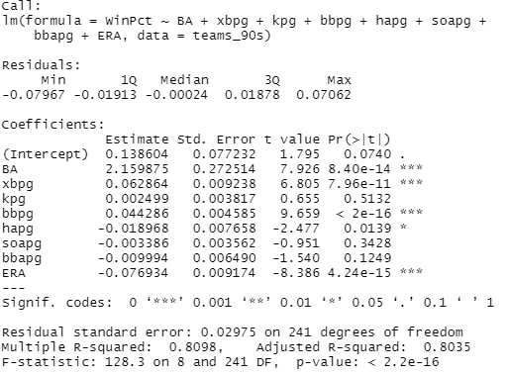
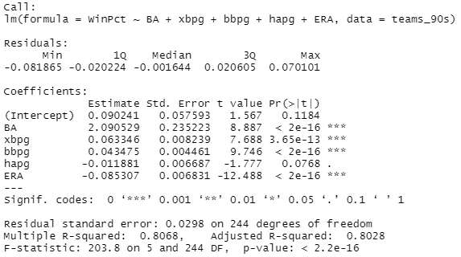
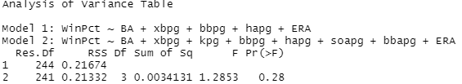
Analysis for years 1990 to 1999
Regression summary for full model fit yielded a p-value > 0.05 for kpg, soapg, and bbapg, thus they were removed.
The reduced model resulted:
WinPct = 2.090529(BA) + 0.063346(xbpg) + 0.043475(bbpg) – 0.011881(hapg) – 0.085307(ERA)
New model passes ANOVA check
VIFs all less than 10

Slide 16
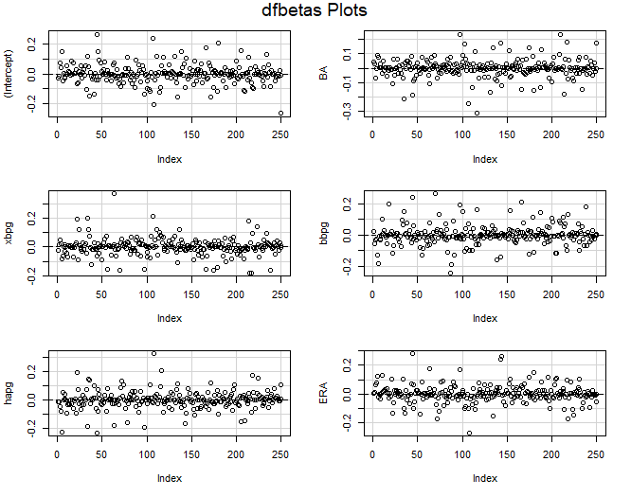
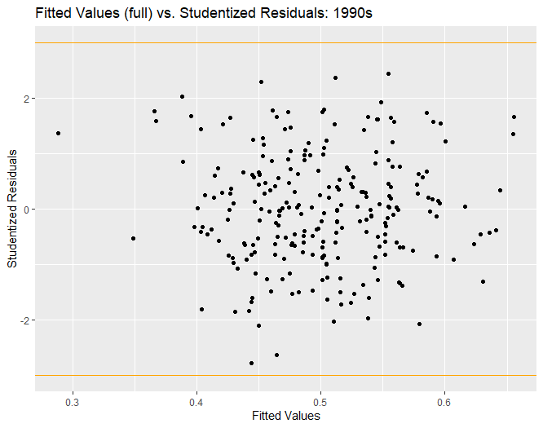
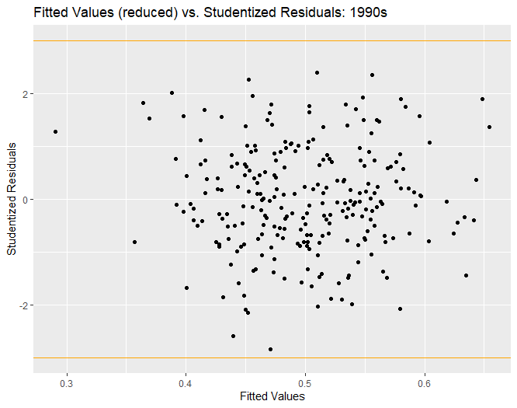
Analysis for years 1990 to 1999
No other transformation on data is necessary, as residuals are randomly distributed between -3 and 3 in a horizontal band
No outliers noticed.

Slide 17
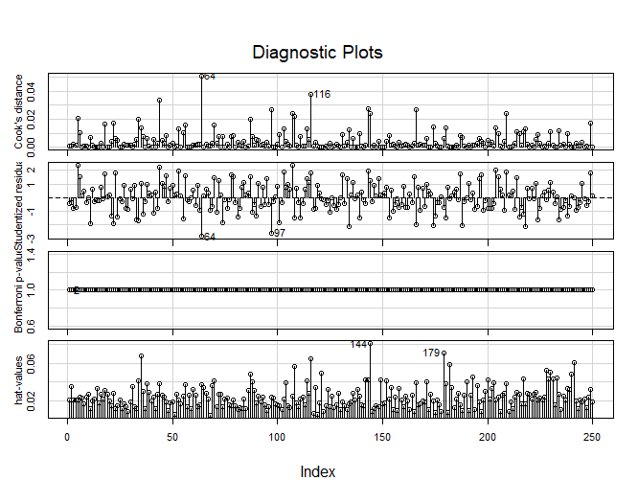
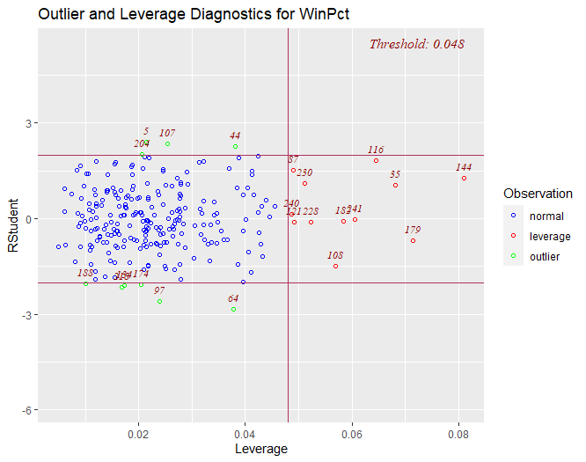
Analysis for years 1990 to 1999
No outliers detected but point 64 (the 1992 Los Angeles Dodgers) is borderline.
Further analysis of high leverage points can be conducted on why these teams either significantly over- or under-performed, respective to the decade they played.

Slide 18
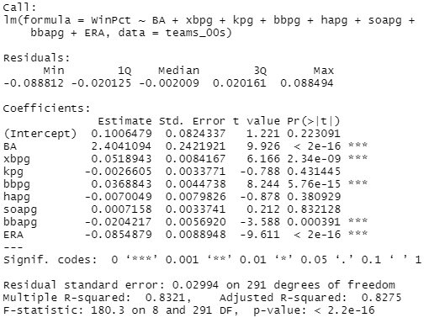
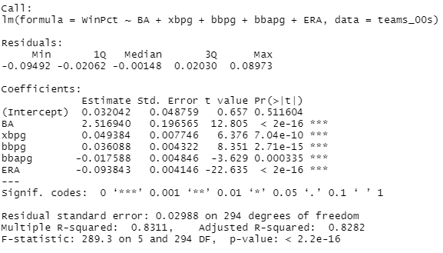
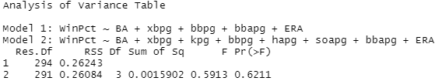
Analysis for years 2000 to 2009
Regression summary for full model fit yielded a p-value > 0.05 for kpg, hapg, and soapg, thus they were removed.
The reduced model resulted:
WinPct = 2.516940(BA) + 0.049384(xbpg) + 0.036088(bbpg) – 0.017588(bbapg) – 0.093843(ERA)
New model passes ANOVA check
VIFs all less than 10

Slide 19
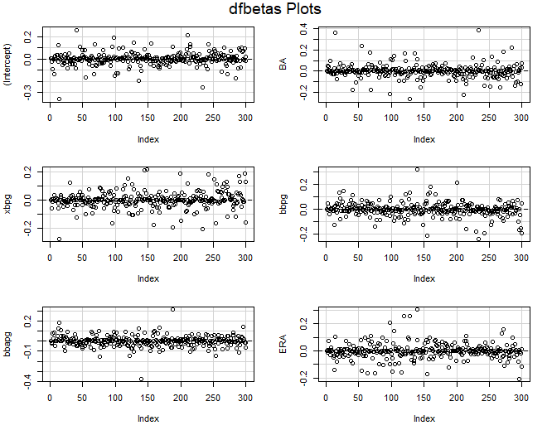
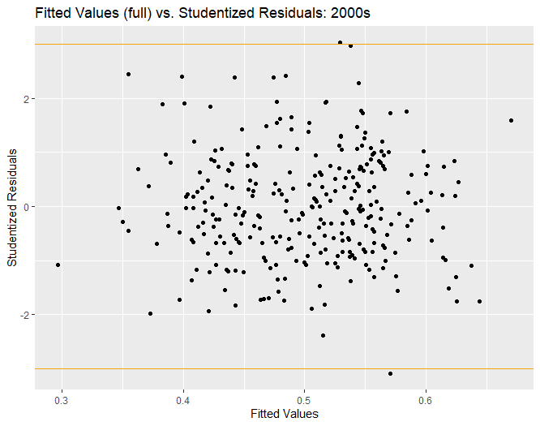
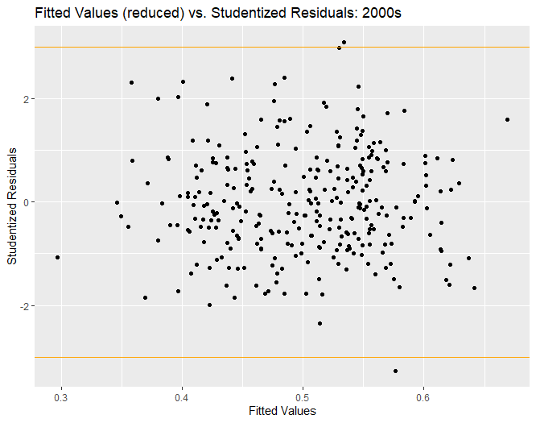
Analysis for years 2000 to 2009
No other transformation on data is necessary, as residuals are randomly distributed between -3 and 3 in a horizontal band
Two possible outliers noticed.

Slide 20
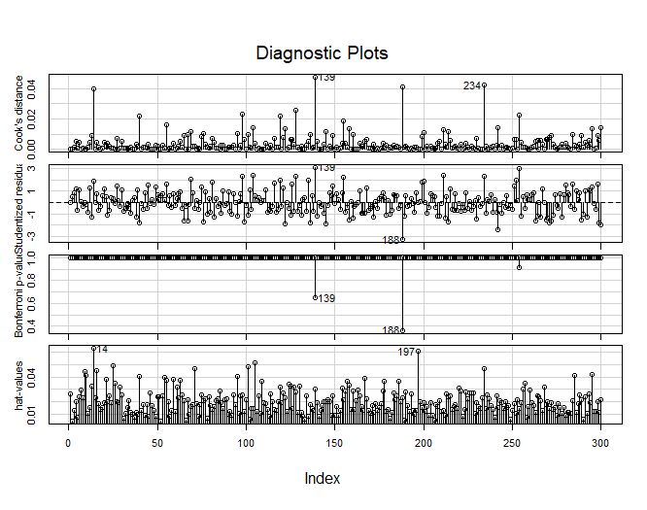
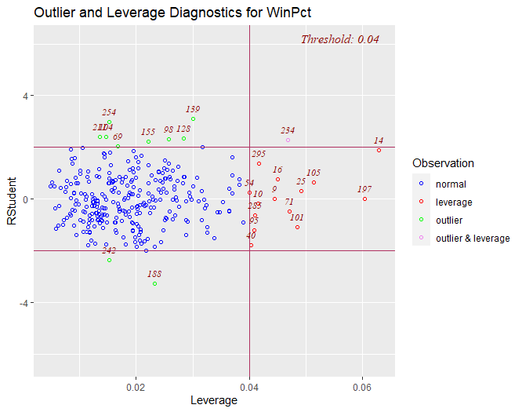
Analysis for years 2000 to 2009
Possible outliers at point 139 (the 2004 New York Yankees) and point 188 (the 2006 Cleveland Indians).
Outlier team that possibly over-performed (‘04 NYY) made the playoffs but did not win the World Series that year.
Further analysis of high leverage points can be conducted on why these teams either significantly over- or under-performed, respective to the decade they played.

Slide 21
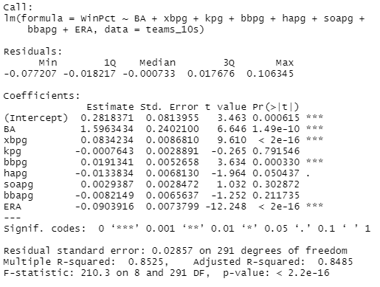
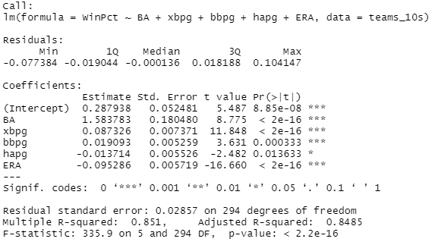

Analysis for years 2010 to 2019
Regression summary for full model fit yielded a p-value > 0.05 for kpg, soapg, and bbapg, thus they were removed.
The reduced model resulted:
WinPct = 1.583783(BA) + 0.087326(xbpg) + 0.019093(bbpg) – 0.013714(hapg) – 0.095286(ERA)
New model passes ANOVA check
VIFs all less than 10

Slide 22



Analysis for years 2010 to 2019
No other transformation on data is necessary, as residuals are randomly distributed between -3 and 3 in a horizontal band
One possible outlier noticed.

Slide 23


Analysis for years 2010 to 2019
Possible outlier at point 139 (the 2016 Texas Rangers).
Outlier in this decade is an overall outlier for all years from 1970 to 2019.
Outlier team lost the World Series that year.
Further analysis of high leverage points can be conducted on why these teams either significantly over- or under-performed, respective to the decade they played.

Slide 24
Conclusions
Variables Batting Average, Extra Base-hits per Game, Walks per Game, and Earned Run Average appear on all reduced models.
Further analysis can seek to answer why remaining variables could be dropped from those decade’s model. Ex: What was unique about play style during that time?
Overall, we can conclude that teams that can hit for a high average and power, get on base via walks at a high rate, and keep a low earned run average are more likely to have a high winning percentage, thus putting them in a better position to make the post-season.
As mentioned previously, predictors were chosen to keep extreme multicollinearity to a minimum. However, we acknowledge that given the nature of baseball statistics, multicollinearity may be unavoidable when choosing different predictors.
Further comparisons and analysis can be done through other analytic means developed for baseball statistics, such as the Pythagorean Win-Loss ratio, which estimates the percentage of games a team “should” have won based on the number of runs scored and runs allowed.

